Slide 1
UNIT-1 Deep Learning-Introduction
Dr Srinivas Gorla
Associate Prof
Department of CSE
GITAM University
9963199200

Slide 2
What Is a Neural Network?
A neural network is a series of algorithms that endeavors to recognize underlying relationships in a set of data through a process that mimics the way the human brain operates. In this sense, neural networks refer to systems of neurons, either organic or artificial in nature.
As such, they tend to resemble the connections of neurons and synapses found in the brain.
They are used in a variety of applications in financial services, from forecasting and marketing research to fraud detection and risk assessment.
Neural networks with several process layers are known as "deep" networks and are used for deep learning algorithms
The success of neural networks for stock market price prediction varies.

Slide 3
Application of Neural Networks
Neural networks are broadly used, with applications for financial operations, enterprise planning, trading, business analytics, and product maintenance. Neural networks have also gained widespread adoption in business applications such as forecasting and marketing research solutions, fraud detection, and risk assessment.

Slide 4
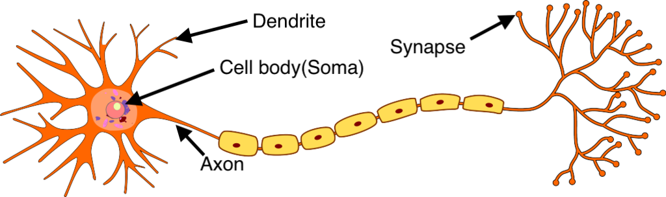
Biological Neurons Vs Artificial Neurons
Biological Neurons
Neurons are the basic functional units of the nervous system, and they generate electrical signals called action potentials, which allows them to quickly transmit information over long distances. Almost all the neurons have three basic functions essential for the normal functioning of all the cells in the body. [Source: https://smhatre59.medium.com/what-is-the-relation-between-artificial-and-biological-neuron-18b05831036]
These are to: 1. Receive signals (or information) from outside. 2. Process the incoming signals and determine whether or not the information should be passed along. 3. Communicate signals to target cells which might be other neurons or muscles or glands.

Slide 5
Dendrite
Dendrites are responsible for getting incoming signals from outside
2. Soma
Soma is the cell body responsible for the processing of input signals and deciding whether a neuron should fire an output signal
3. Axon
Axon is responsible for getting processed signals from neuron to relevant cells
4. Synapse
Synapse is the connection between an axon and other neuron dendrites

Slide 6
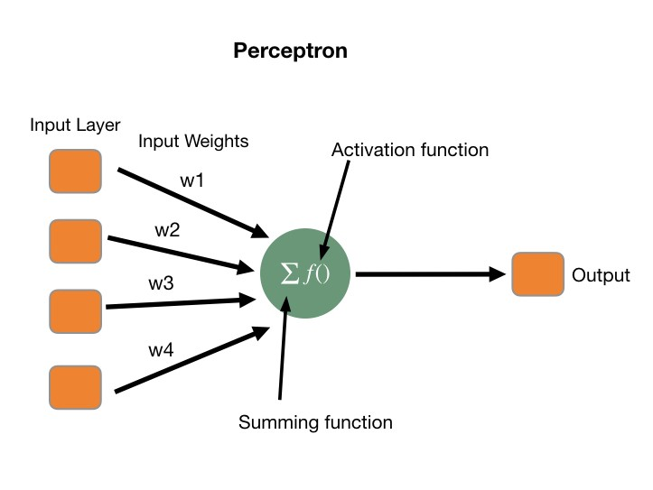
Artificial Neurons
Artificial neuron also known as perceptron is the basic unit of the neural network. In simple terms, it is a mathematical function based on a model of biological neurons. It can also be seen as a simple logic gate with binary outputs. They are sometimes also called perceptron's.
Each artificial neuron has the following main functions:
Takes inputs from the input layer
Weighs them separately and sums them up
Pass this sum through a nonlinear function to produce output.

Slide 7
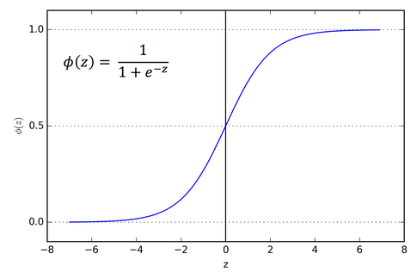
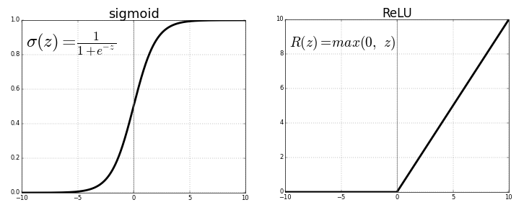
Activation Functions
Sigmoid or Logistic Activation Function
The Sigmoid Function curve looks like a S-shape.
Therefore, it is especially used for models where we have to predict the probability as an output.Since probability of anything exists only between the range of 0 and 1, sigmoid is the right choice.
The ReLU (Rectified Linear Unit) is the most used activation function in the world right now. Since, it is used in almost all the convolutional neural networks or deep learning.

Slide 8
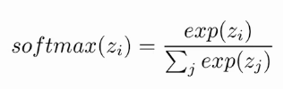
Similar to the sigmoid activation function the SoftMax function returns the probability of each class. Here is the equation for the SoftMax activation function.

Slide 9
what is multi-layer perception?
Multi-layer perception is the basic type of algorithm used in deep learning it is also known as an artificial neural network and they are the most useful type of neural network.
They are connected to multiple layers in a directed graph a perceptron is a single neuron model that was a precursor to large neural Nets it is a field of study that investigates how simple models of the biological brain can be used to solve different computational tasks.
The goal is to create robust algorithms and data structures that can be used to model difficult problems MLP utilizes a supervised learning technique called backpropagation.
MLP is used to solve regression and classification problems we use MLP in speech and image processing computer vision time series prediction and machine translation.
In MLP neurons are arranged into networks a row of neurons is called a layer and one network can have multiple layers any network model starts with an input layer that takes input from the data set layers after the input layer are called hidden layers.
[Source: http://www.dwbiadda.com/how-to-implement-mlp-multilayer-perceptron-in-keras/]

Slide 10
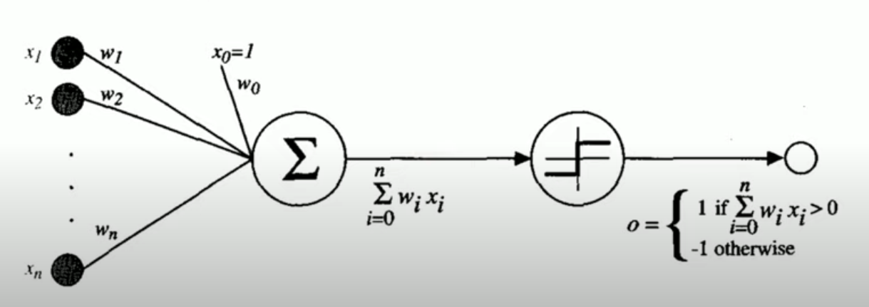
Perceptron

Slide 11
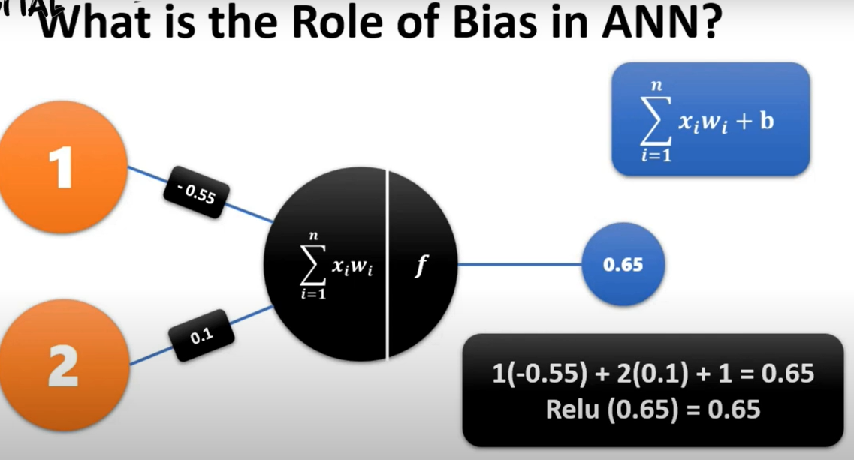

Slide 12
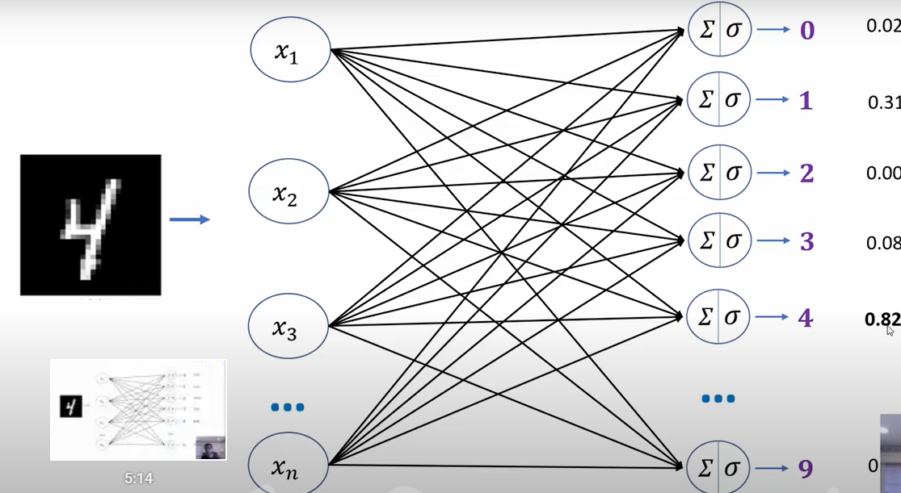

Slide 13
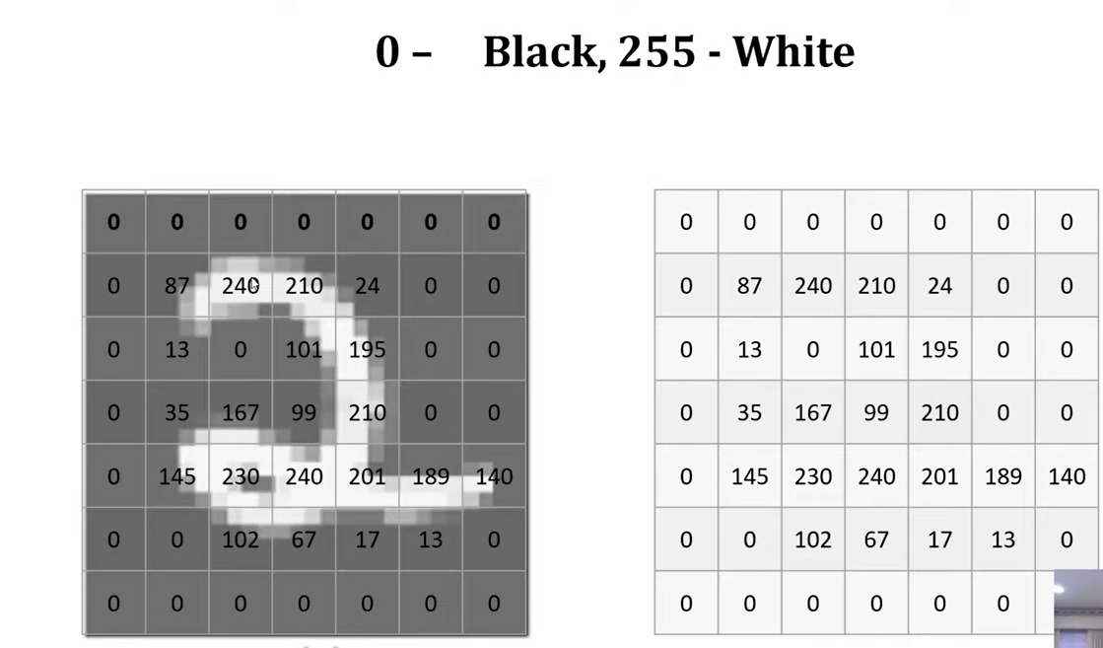

Slide 14
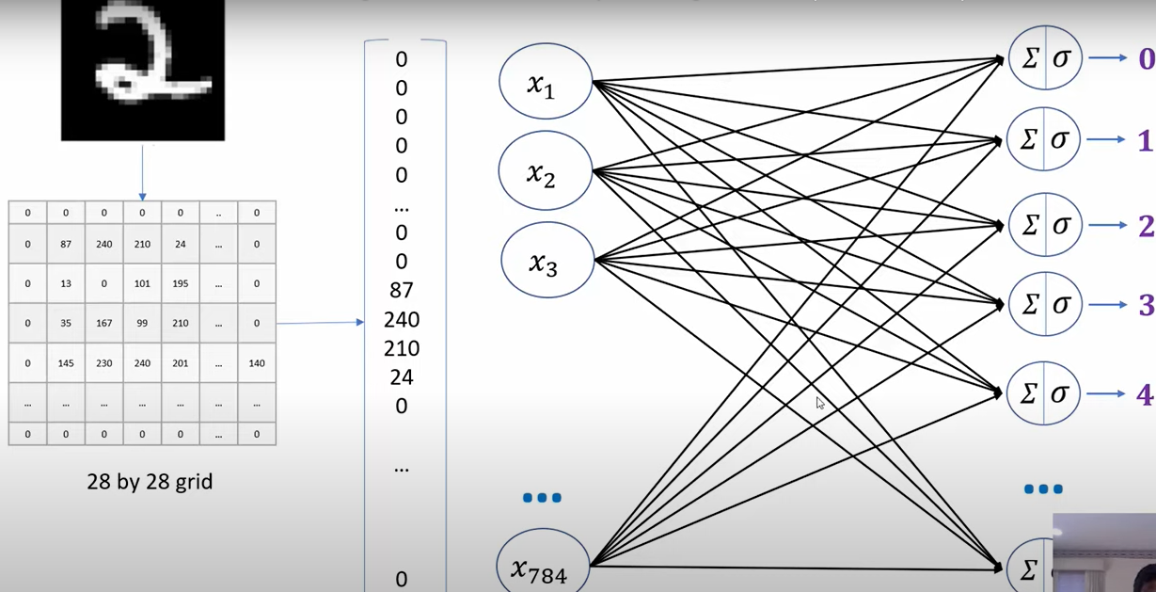
How to Build Prior Information into Neural Network Design

Slide 15
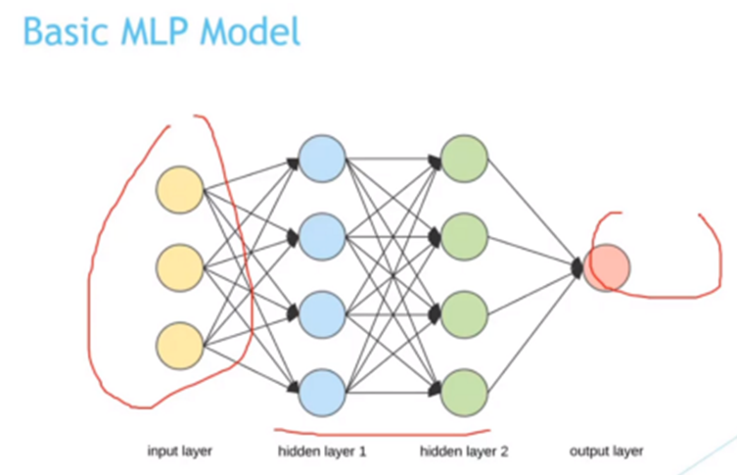

Slide 16
In the above example, we have two hidden layers.
The final layer is called the output layer and it is responsible for the final outcome.
If we are modeling a regression problem may have a single output neuron and the neuron may have no activation function a binary classification problem may have a single output neuron and use a sigmoid activation function to output a value between zero and one
A multi-class classification problem may have multiple neurons in the final output layer

Slide 17
Types of neural networks
There are many types of neural networks available or that might be in the development stage.
Perceptron:
one of the simplest and oldest models of Neuron. It is the smallest unit of neural network that does certain computations to detect features or business intelligence in the input data. It accepts weighted inputs, and apply the activation function to obtain the output as the final result.
Advantages of Perceptron Perceptrons can implement Logic Gates like AND, OR, or NAND.
Disadvantages of Perceptron Perceptrons can only learn linearly separable problems such as boolean AND problem. For non-linear problems such as the boolean XOR problem, it does not work.

Slide 18
Feed Forward Neural Networks
Applications on Feed Forward Neural Networks:
Simple classification
Face recognition
Computer vision
Speech Recognition
The simplest form of neural networks where input data travels in one direction only, passing through artificial neural nodes and exiting through output nodes. Where hidden layers may or may not be present, input and output layers are present there.
Advantages of Feed Forward Neural Networks
Less complex, easy to design & maintain
Fast and speedy [One-way propagation]
Highly responsive to noisy data
Disadvantages of Feed Forward Neural Networks:
Cannot be used for deep learning [due to absence of dense layers and back propagation

Slide 19
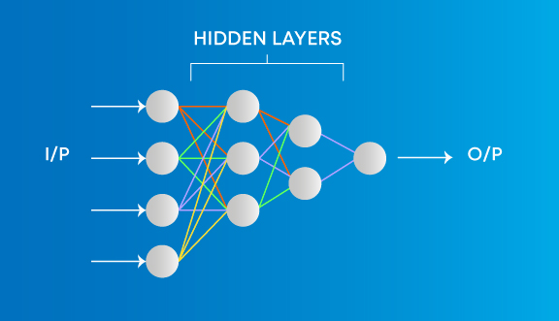
Multilayer Perceptron
Every single node is connected to all neurons in the next layer which makes it a fully connected neural network. Input and output layers are present having multiple hidden Layers i.e. at least three or more layers in total.
Advantages on Multi-Layer Perceptron
Used for deep learning [due to the presence of dense fully connected layers and back propagation]
Disadvantages on Multi-Layer Perceptron:
Comparatively complex to design and maintain

Slide 20
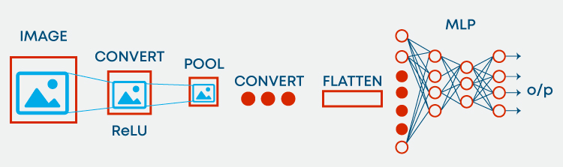
Convolution Neural Networks
CNN captures the spatial features from an image. Spatial features refer to the arrangement of pixels and the relationship between them in an image. They help us in identifying the object accurately, the location of an object, as well as its relation with other objects in an image

Slide 21
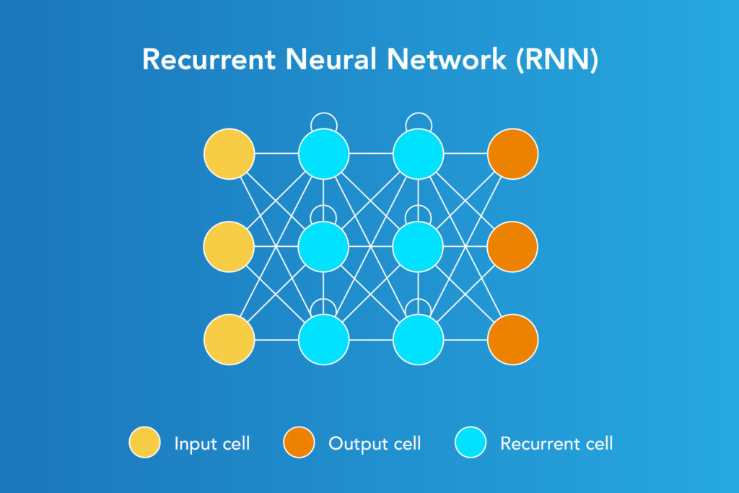
Recurrent Neural Network
Applications of Recurrent Neural Networks
Text processing like auto suggest, grammar checks, etc.
Text to speech processing
Image tagger
Recurrent Neural Network is fed back to the input to help in predicting the outcome of the layer. The first layer is typically a feed forward neural network followed by recurrent neural network layer where some information it had in the previous time-step is remembered by a memory function

Slide 22
Fine tuning neural network hyperparameters.
The hyperparameters to tune are the number of neurons, activation function, optimizer, learning rate, batch size, and epochs.
The second step is to tune the number of layers. This is what other conventional algorithms do not have. Different layers can affect the accuracy.
The layers of a neural network are compiled and an optimizer is assigned. The optimizer is responsible to change the learning rate and weights of neurons in the neural network to reach the minimum loss function.
Optimizer is very important to achieve the possible highest accuracy or minimum loss. There are 7 optimizers to choose from. Each has a different concept behind it. The mostly used optimizers are ADAM, RMSPROP and SGD.
A higher learning rate makes the model learn faster, but it may miss the minimum loss function and only reach the surrounding of it.
The number of times a whole dataset is passed through the neural network model is called an epoch. One epoch means that the training dataset is passed forward and backward through the neural network once.

Slide 23

Fine tuning neural network hyperparameters
A too-small number of epochs results in underfitting because the neural network has not learned much enough. The training dataset needs to pass multiple times or multiple epochs are required. On the other hand, too many epochs will lead to overfitting where the model can predict the data very well,
Evaluation (Activation function)
The output calculation is straightforward.
Compute the dot product of the input and weight vector
Add the bias
Apply the activation function.

Slide 24
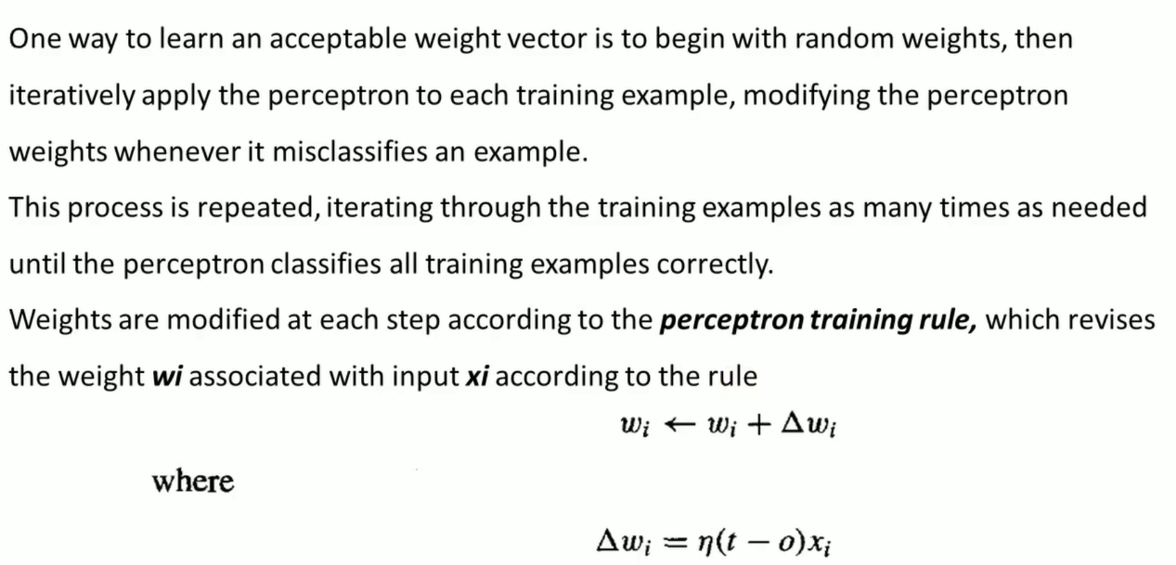
Learning Rate

Slide 25
Back Propagation Algorithm
Calculate the error — How far is your model output from the actual output.
Error minimum — Check whether the error is minimized or not.
Update the parameters — If the error is huge then, update the parameters (weights and biases). After that again check the error.
Model is ready to make a prediction — Once the error becomes minimum, you can feed some inputs to your model and it will produce the output.

Slide 26
Machine Learning | Deep Learning
Although machine learning depends on the huge amount of data, it can work with a smaller amount of data. | Deep Learning algorithms highly depend on a large amount of data, so we need to feed a large amount of data for good performance.
Machine learning algorithm takes less time to train the model than deep learning, but it takes a long-time duration to test the model. | Deep Learning takes a long execution time to train the model, but less time to test the model.
Since machine learning models do not need much amount of data, so they can work on low-end machines. | The deep learning model needs a huge amount of data to work efficiently, so they need GPU's and hence the high-end machine.
To solve a given problem, the traditional ML model breaks the problem in sub-parts, and after solving each part, produces the final result. | The problem-solving approach of a deep learning model is different from the traditional ML model, as it takes input for a given problem, and produce the end result. Hence it follows the end-to-end approach.
Machine learning models mostly require data in a structured form. | Deep Learning models can work with structured and unstructured data both as they rely on the layers of the Artificial neural network.
Machine learning models are suitable for solving simple or bit-complex problems. | Deep learning models are suitable for solving complex problems.

